Slide 1
Persuasive Mental Health Technology
By: Adrian Chan, Evelyn Li, Sameeha Fatima

Slide 2
Background
Mental Health Crisis and NC State
½ of student body reported experiencing “moderate psychological stress” in the 2020-2021 school year
7 students died from suicide in the 2021-2022 school year
Question: How do assure that users are able to get the help they need for their mental health?

Slide 3
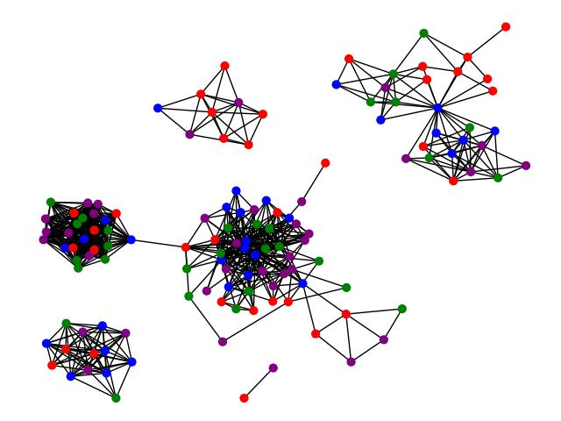
How We Addressed This Problem
Hypothesis: creating a simulation based of persuasion will reduce the resources needed for testing new approaches on addressing the mental health crisis
Create a realistic simulation:
Combine Ego Nets
Update values based on connected nodes
Track mental and app states
Example Society Graph

Slide 4
Results of Our Approach

Slide 5
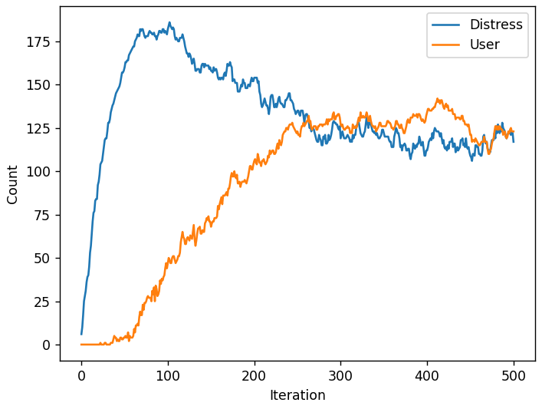
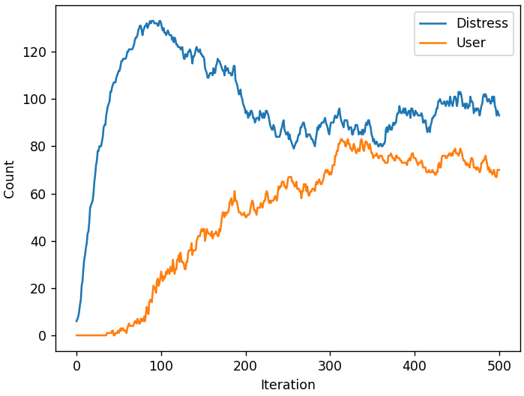
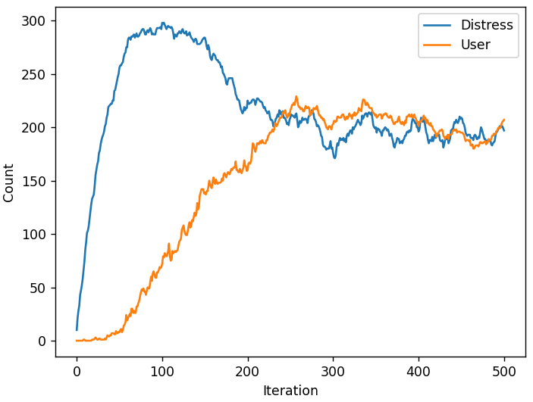
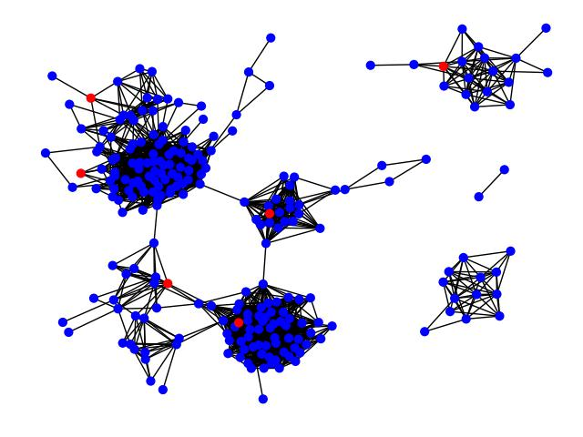
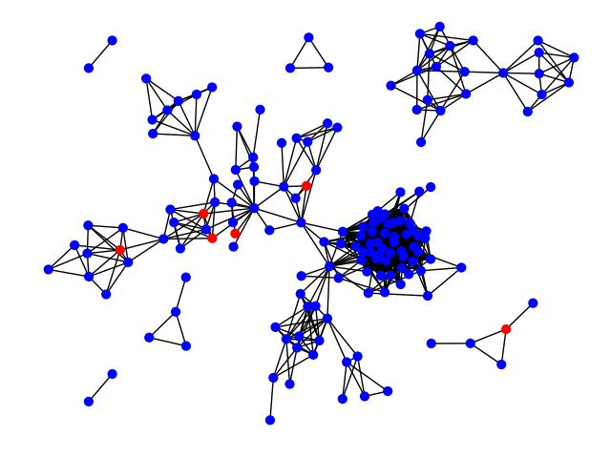
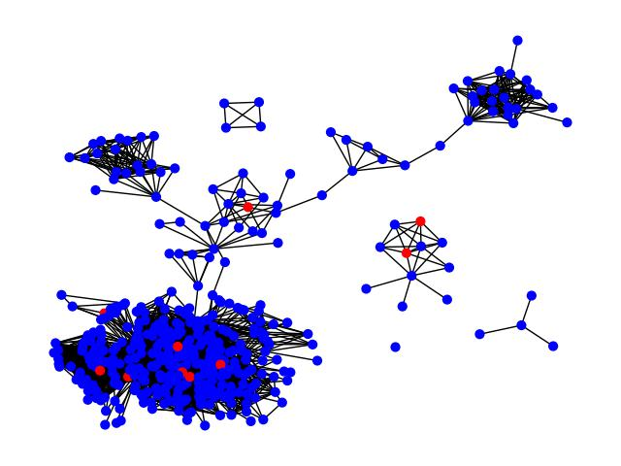
Effectiveness
Qualitative assessment of each graph: making sure it aligned with the literature we reviewed on persuasion and mental health
Ensure that the graphs reflect real-world behavioral patterns and psychological principles
Distress & User Correlation Graphs
Society Graphs

Slide 6
Alternatives?
Relying exclusively on app development and in-world testing
Time-consuming
Testing would require a large amount of active users
User adoption can be unpredictable
Notes:
An alternative to our current strategy is to rely exclusively on app development and conducting real-world testing
However, this alternative would be more time-consuming and potentially less productive, particularly given that apps of this nature essentially function as social media apps
Also, user adoption can be unpredictable because deriving meaningful insights from such testing would mean having to amass a large amount of users who actively engage with the app

Slide 7
Main Findings
Necessity for mental health resource apps to meet the evolving needs of a dynamic social network
Understanding pertinent parameters for tracking such as distress and recovery rate is essential
Researchers can leverage this model to comprehend user interactions during period of distress
Notes:
The main findings from this project is the necessity for mental health resource apps to meet the evolving needs of a dynamic social network
Understanding the pertinent parameters for tracking, such as distress and recovery rates, is essential to guide the app’s evolution and assess the the impact of different parameter configurations on social networks
Additionally, researchers can leverage this model to comprehend user interactions during periods of distress, exploring how these interactions are influenced by parameters like distress and recovery rates

Slide 8
Limitations
Tackling the broad topic of mental health
Solution must accommodate a wide variety of generalizations and conditions
Requires a large amount of computational time
Had to cut down on the size of the model’s implementation
Cutting down on size meant that the model’s representation of human cognition and persuasion is less accurate
Mental health status is computed as a boolean
This reduces the granularity of our model in modeling mental health but helps improve computational speed
Notes:
One of the main limitations stem from attempting to test the broad topic of mental health
This means that the solution we come up needed to accommodate a large number of of generalizations and conditions
Another limitation was that this project requires a large amount of computational time. We had to cut down on the size of the model’s implementation. Ut cutting down on size meant that the model’s representation of human cognition and persuasion is less accurate
Additionally, mental health status is computed as a boolean
This reduces the precision and amount of detail that put into our model, but this helps to increase the computational speed of the program

Slide 9
Demo

